Slide 1
ONLINE TICKET BOOKING FOR RED BUS {TESTING USING APPIUM}
GOWARAPPAGARI GANESH 192011088
CSE
CSA3731 SOFTWARE TESTING FOR ANDRIOD APPLICATIONS
31-01-2023

Slide 2
PROJECT INCLUDES
Abstract
Proposed system
Objective
Flow chart
Concept map
No of test cases
Apps and tools installation
Appium server
Implementing testing
Test cases out comes
Conclusion

Slide 3
Abstract
The online bus ticket reservation system application that allows Users check bus ticket availability, buy bus ticket and pay the bus ticket online
This system is established for all the home/office users after gaining access from the administrator. Online bus reservation system provides bus transportation system, a facility to reserved seats, cancellation of seats and different types of enquiry which need an instant and quick reservation
This system can be used by the users in performing online reservation via internet for all the business users

Slide 4
OBJECTIVE:
To test the different strategies {TEST CASES} on online ticket booking application

Slide 5
PROPOSED WORK:
Login,timings of buses,destination,availability of buses,tracking of buses,payments,ticket generation all these will be tested
Run the ticket booking application using emulator
Testing will be done for the both positive and negative outcomes
Automatically the appium will interact with application and run the test cases

Slide 6
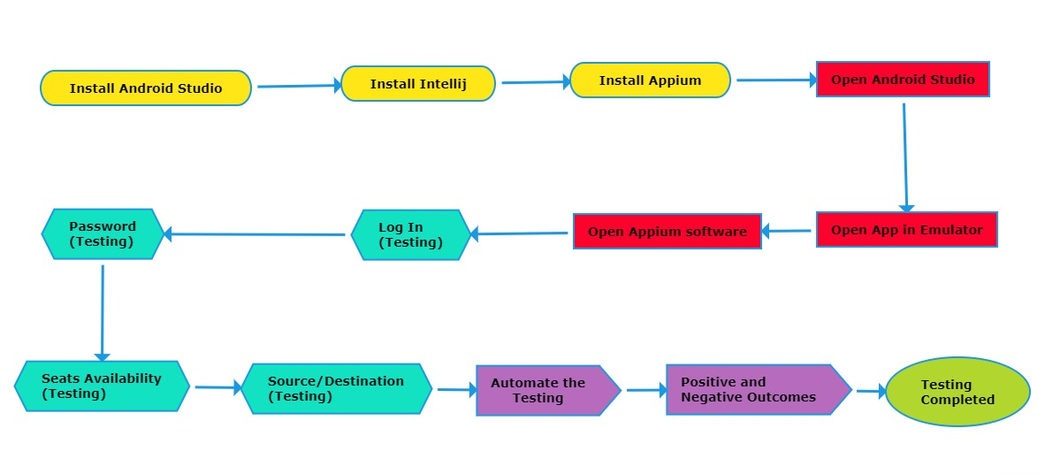
FLOW CHART

Slide 7
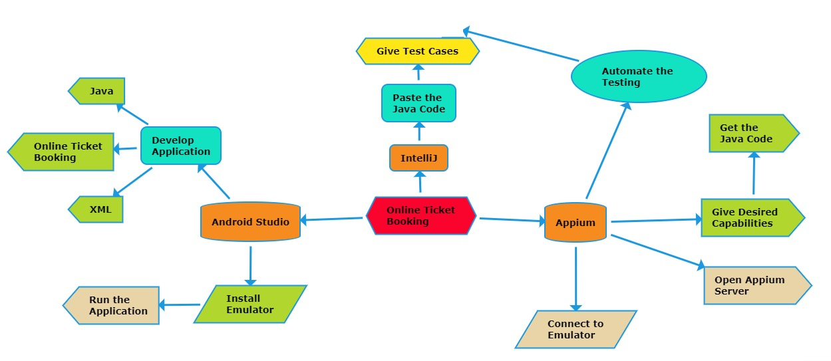
CONCEPT MAP

Slide 8
TEST CASES
Login
User name
Password
Checking availability
Ticket booking
Ticket cancellation
Payment
Tracking of bus
Source
destination

Slide 9



Apps and tools installation

Slide 10
Apps and tools:
Appium:
Appium is an open source tool for automating native , mobile , and android hybrid applications on ios mobile
Appium is an open-source framework that allows to conduct automated app testing on different platforms like android, ios, and windows.
It automates testing for: native mobile applications
Appium is cross-platform compatible, means you can use it to test apps on both android and ios devices.

Slide 11
Android studio:
Android studio is the official integrated development environment (IDE) for android application development.
Android studio provides more features that enhance our productivity while building android apps.
Android studio provides extensive testing tools and frameworks

Slide 12
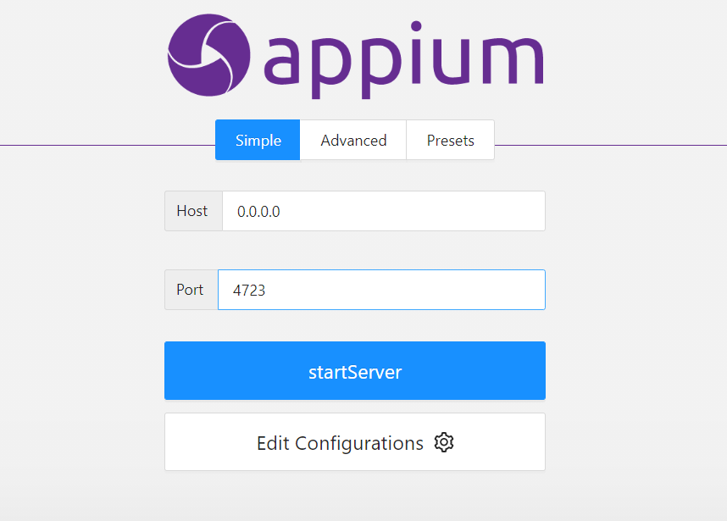
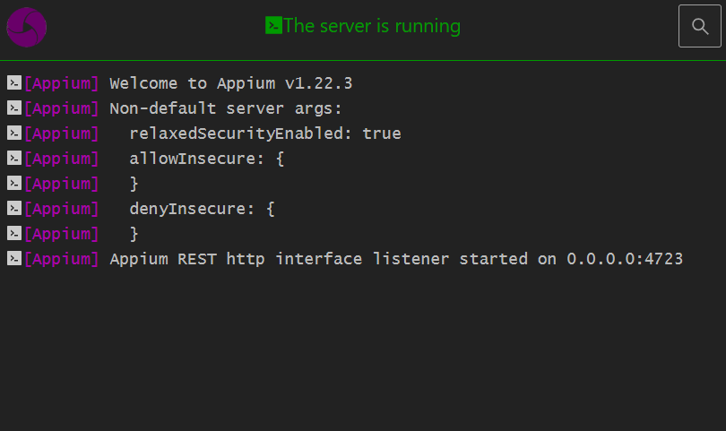
APPIUNM SERVER

Slide 13
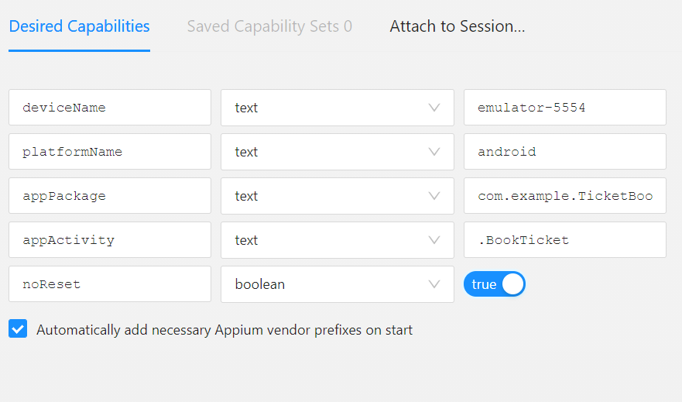
IMPLEMENTATION AND TESTING{APPIUM INSPECTOR}
Give the desired capabilities in appium inspector
It will start the session and give you the java code to start testing
Paste the code in intellij ide and start the testing

Slide 14
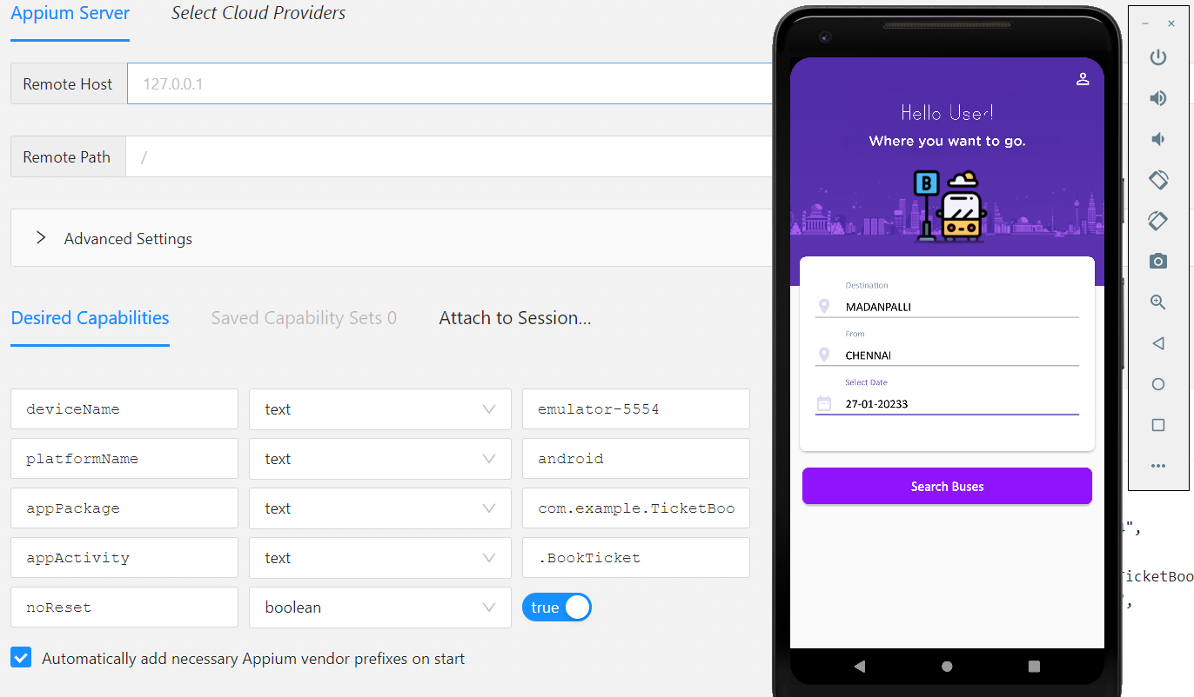
Testing outcome

Slide 15
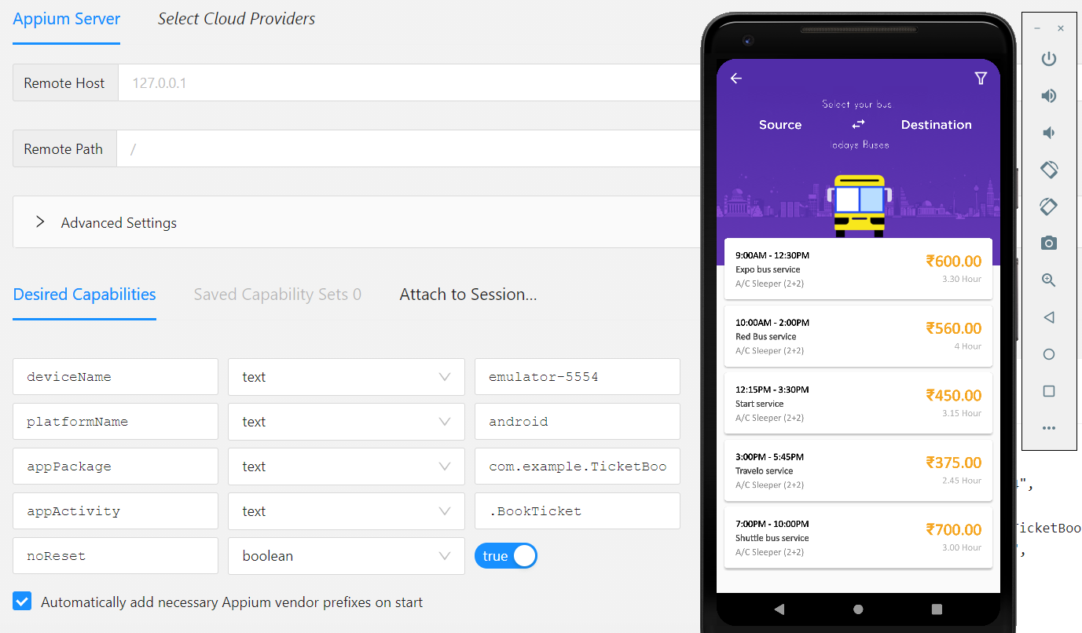
Testing outcome

Slide 16
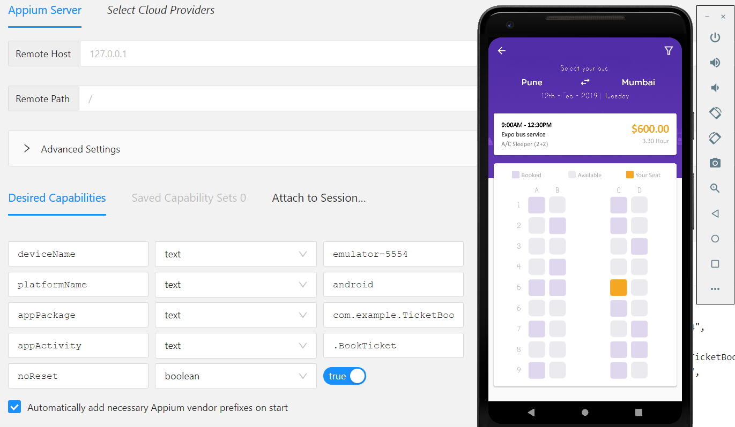
Testing outcome

Slide 17
Test case outcome
TEST CASE | OUTCOME
Verify if user will able to login with valid user name | Positive
Verify if user will able to login with valid password | Positive
User will able to see live tracking | Negative
Verifying the different destinations | Positive
Verifying the different source | Positive
Checking whether the ticket is cancelled or not cancellation required | Positive
Verifying on payment whether its completed or not successfully | Positive
Verifying on feedback form | Positive
Verifying on INSTANT refund(money transformation)after ticket cancellation | Negative
Testing of the offline payPment | Negative

Slide 18
CONCLUSION
Hence online ticket booking application is tested using the appium software.
All the possible outcomes and parameters are tested using appium server
70% test cases were tested positive in the testing process
30%test cases were tested negative in the testing process

